Slide 1
ADPG
Adaptive Demotion Policy with Global fluctuations of Priority Values
Piyush Deshpande
Ranjan Raut
Rohan Hulsure
Vatsal Vador

Slide 2
Outline
Motivation
Background
ADP-G
Project Plan
Expectation
References

Slide 3

Motivation
Ideal Cache
Cache can be made smarter, self-tuning and low-overhead to reduce hardware costs.
What are we looking for?
Cache that is fast and fault tolerant.
Easy to construct
Provides good temporal and spatial locality

Slide 4
Motivation
Enhance cache performance
Motivation
Enhance cache performance
Reduce miss rate
Reduce the miss penalty
Reduce the time to hit in the cache

Slide 5
Motivation
With advancement in computer architecture, caching techniques have become hot topic for research.
Adaptive Demotion Policy with priority calculations evolved in 2017 aiming to reduce cache miss rates.
The policy has a big impact on future computer architecture designs.

Slide 6
Background

Slide 7
Least Recently Used Policy
High performance replacement policy in high associativity cache.
Exploits Locality.
“LRU state bits” for recording order of references
For N-way set associative cache log₂ N bits are used for order or reference
Items are added to cache as they are accessed.
On full, least recently used item is ejected.
Implemented as linked list (doubly).
Item moved back to head of the queue when accessed again.
Removed from the tail.

Slide 8
Least Recently Used Policy
Cache
Tag
V
LRU
A
B
C
D
0
1
2
3
Considering a single set having 4 blocks in 4 way set associative cache with Tag and Valid bits. LRU will store order of references of the blocks.

Slide 9
Least Recently Used Policy
Cache
Tag
V
LRU
E
B
C
D
0
1
2
3
3
0
1
2
Block A changes to E as it had the least reference in the order. The reference order of E has been increased to 3 while decremented for others.

Slide 10
Least Recently Used Policy
Cache
Tag
V
LRU
E
F
C
D
0
1
2
3
3
0
1
2
2
3
0
1
F replaces B in the cache due to lower reference order bit. Highest order bit given to F and decremented for remaining blocks

Slide 11
Least Recently Used Policy
Cache
Tag
V
LRU
E
F
C
D
0
1
2
3
3
0
1
2
2
3
0
1
1
2
3
0
C has been accessed therefore the reference order bit has been maximized.

Slide 12
Disadvantages of LRU
As associativity increases LRU state bit increase hardware resource increases.
Control logic gets more complex.
Eventually effects cycle time as we need to update state bits on every cache access.
LRU has low tolerance to scan access pattern.
LRU considers order of references.
New Block remains in cache for a longer amount of time if block never re-referred
Overflow by blocks that are not re-referred.

Slide 13
Re-Reference Interval Prediction
High performance policy that can suppress hardware cost.
Priority value is prepared for each block.
At cache hit, Priority value promoted
At cache miss, block that has minimum priority is searched
If exist, the block is evicted
If not, the priorities of all the block are decreased by one. The searching and decrement are repeated until a block with the minimum priority is found out.

Slide 14
Disadvantages of RRIP
When the miss rate of the cache is high, a cache miss minimizes the priorities of all the existing blocks in the set.
This causes a harmful effect to the performance by evicting useful data.
If there are blocks that have the minimum priority, the priorities of the blocks in the set are not decreased even though a cache miss occurs.
This causes remaining unnecessary data in the cache and decreases the performance.

Slide 15
ADPG Adaptive Demotion Policy with Global fluctuations of Priority Values

Slide 16
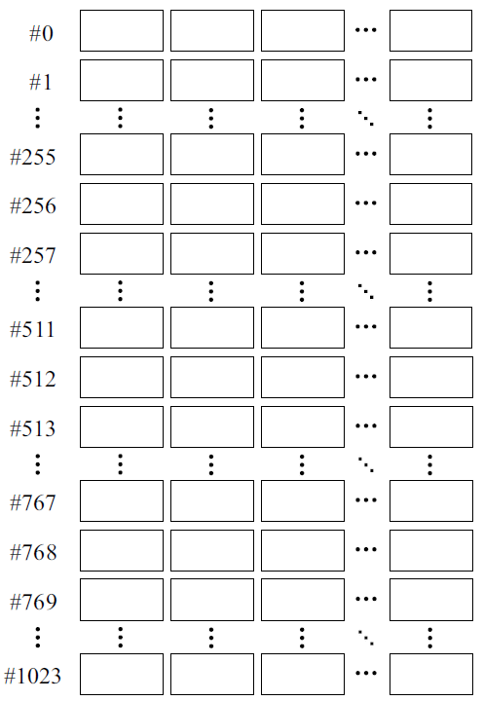
n-Way Set Associative Cache
# of set | Way #1 | Way #2 | Way #3
Way #n

Slide 17
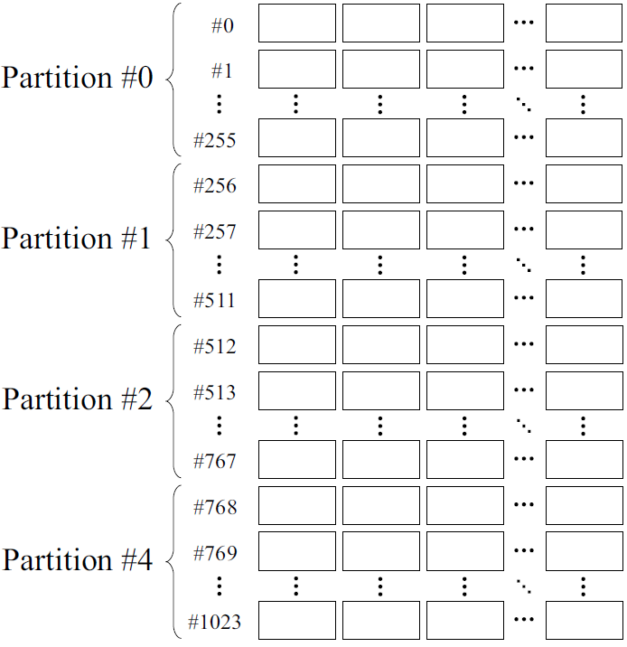
Consolidate Sets into Multiple Partitions
# of set | Way #1 | Way #2 | Way #3
Way #n

Slide 18
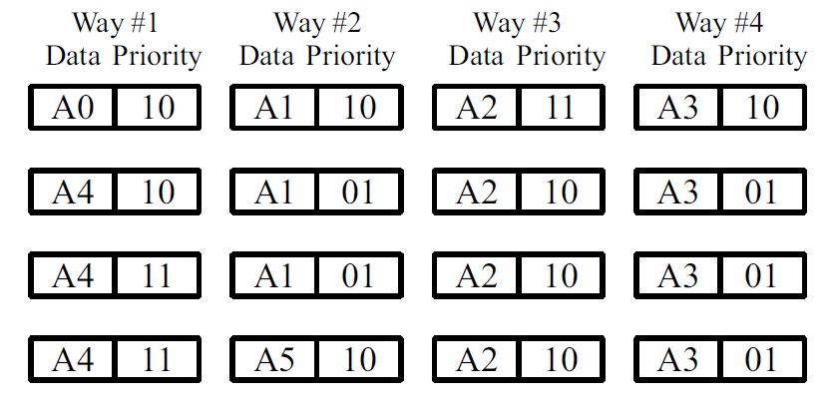
Priority Value to Each Cache Block

Slide 19
IPDS Policies
Insertion Policy
I0 b. I1 c. I2 d. I3
Promotion Policy
HP b. FP
Demotion Policy
HOA b. AVE
Selection Policy
LS b. RS

Slide 20
1. Insertion Policy
- Sets initial priority of block when placed in Cache
Policy | Priority
I0 | 00
I1 | 01
I2 | 10
I3 | 11

Slide 21
2. Promotion Policy
Promote cache block priority in case of Hit
Hit Priority Policy (HP)
increment priority value to Maximum value
Frequency Priority Policy (FP)
increment priority value by 1

Slide 22
3. Demotion Policy
3. Demotion Policy
Decrement all cache block’s priority value in set by subtraction value in case of miss
Subtraction value is calculated for each cache hit and miss
Half Of Average Policy (HOA)
Decrease priority value of all blocks in set by half of average of all priority values of blocks in set
Average Policy (AVE)
Decrease priority value of all blocks in set by average of all priority values of blocks in set

Slide 23
4. Selection Policy
Selects cache block with minimum priority for replacement
In case, many blocks within set have same minimum priority, then below policies decide candidate for replacement.
Left-side Selection Policy (LS)
Select leftmost block as a candidate from set
Random Selection Policy (RS)
Select random block as a candidate from set

Slide 24
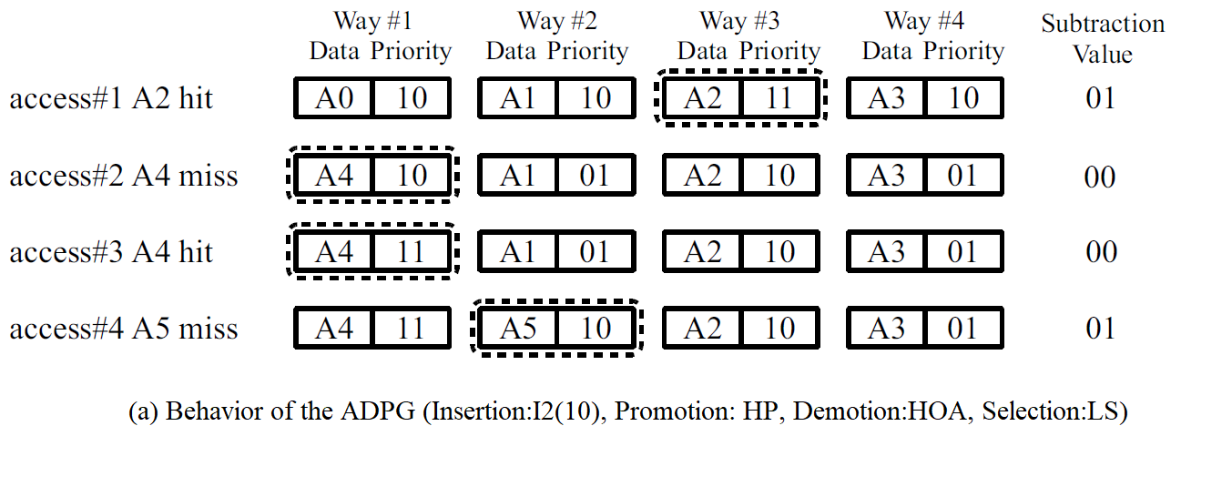
Behaviour of Cache with IPDS

Slide 25
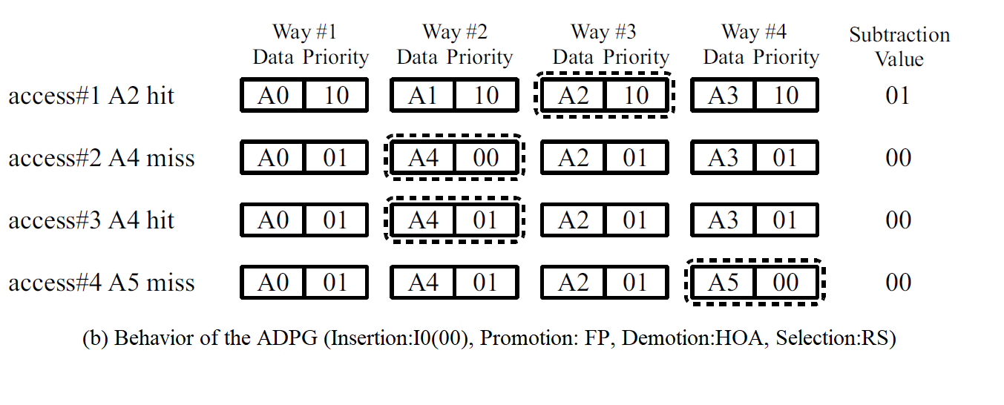
Behaviour of Cache with IPDS
Behaviour of Cache with IPDS

Slide 26
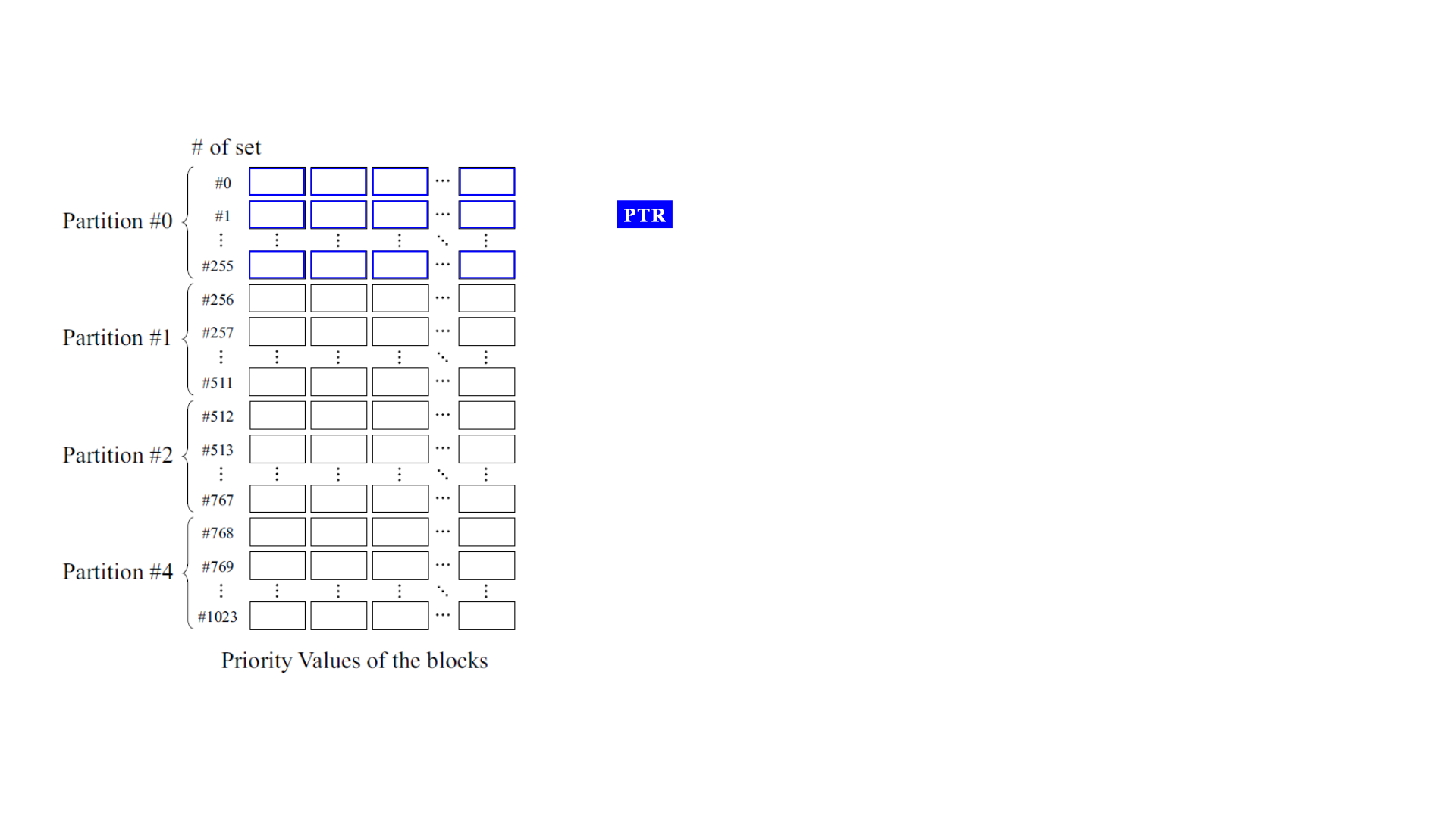
Register Mapping

Slide 27
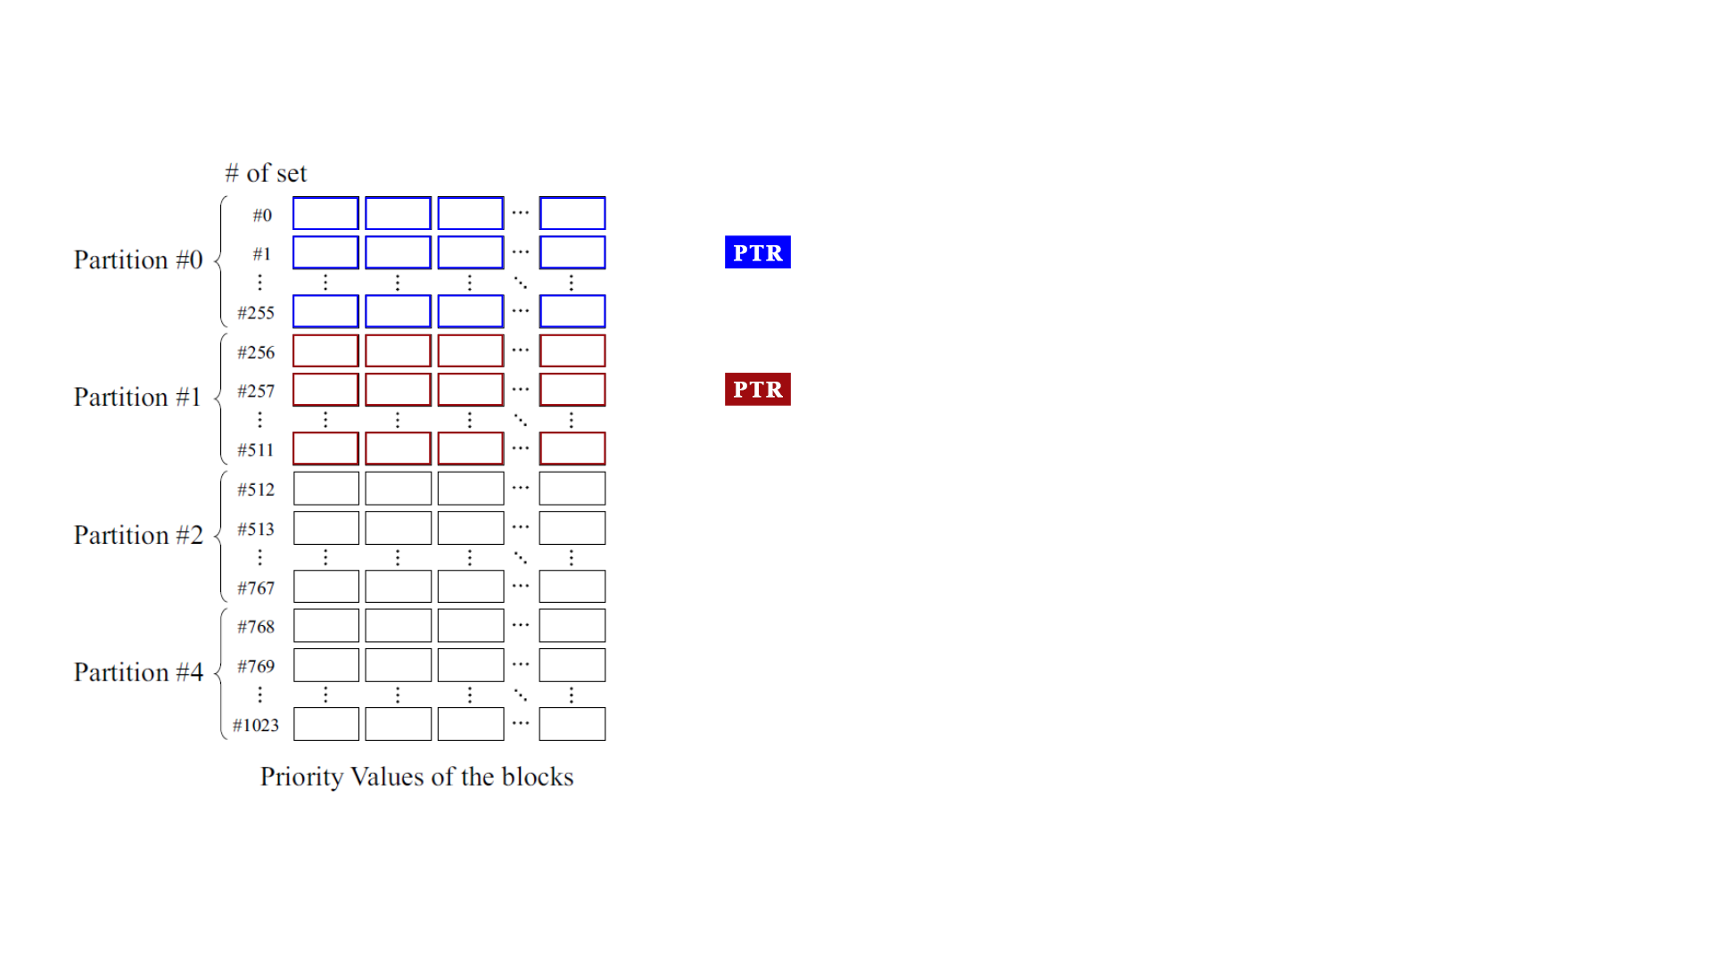
Register Mapping

Slide 28
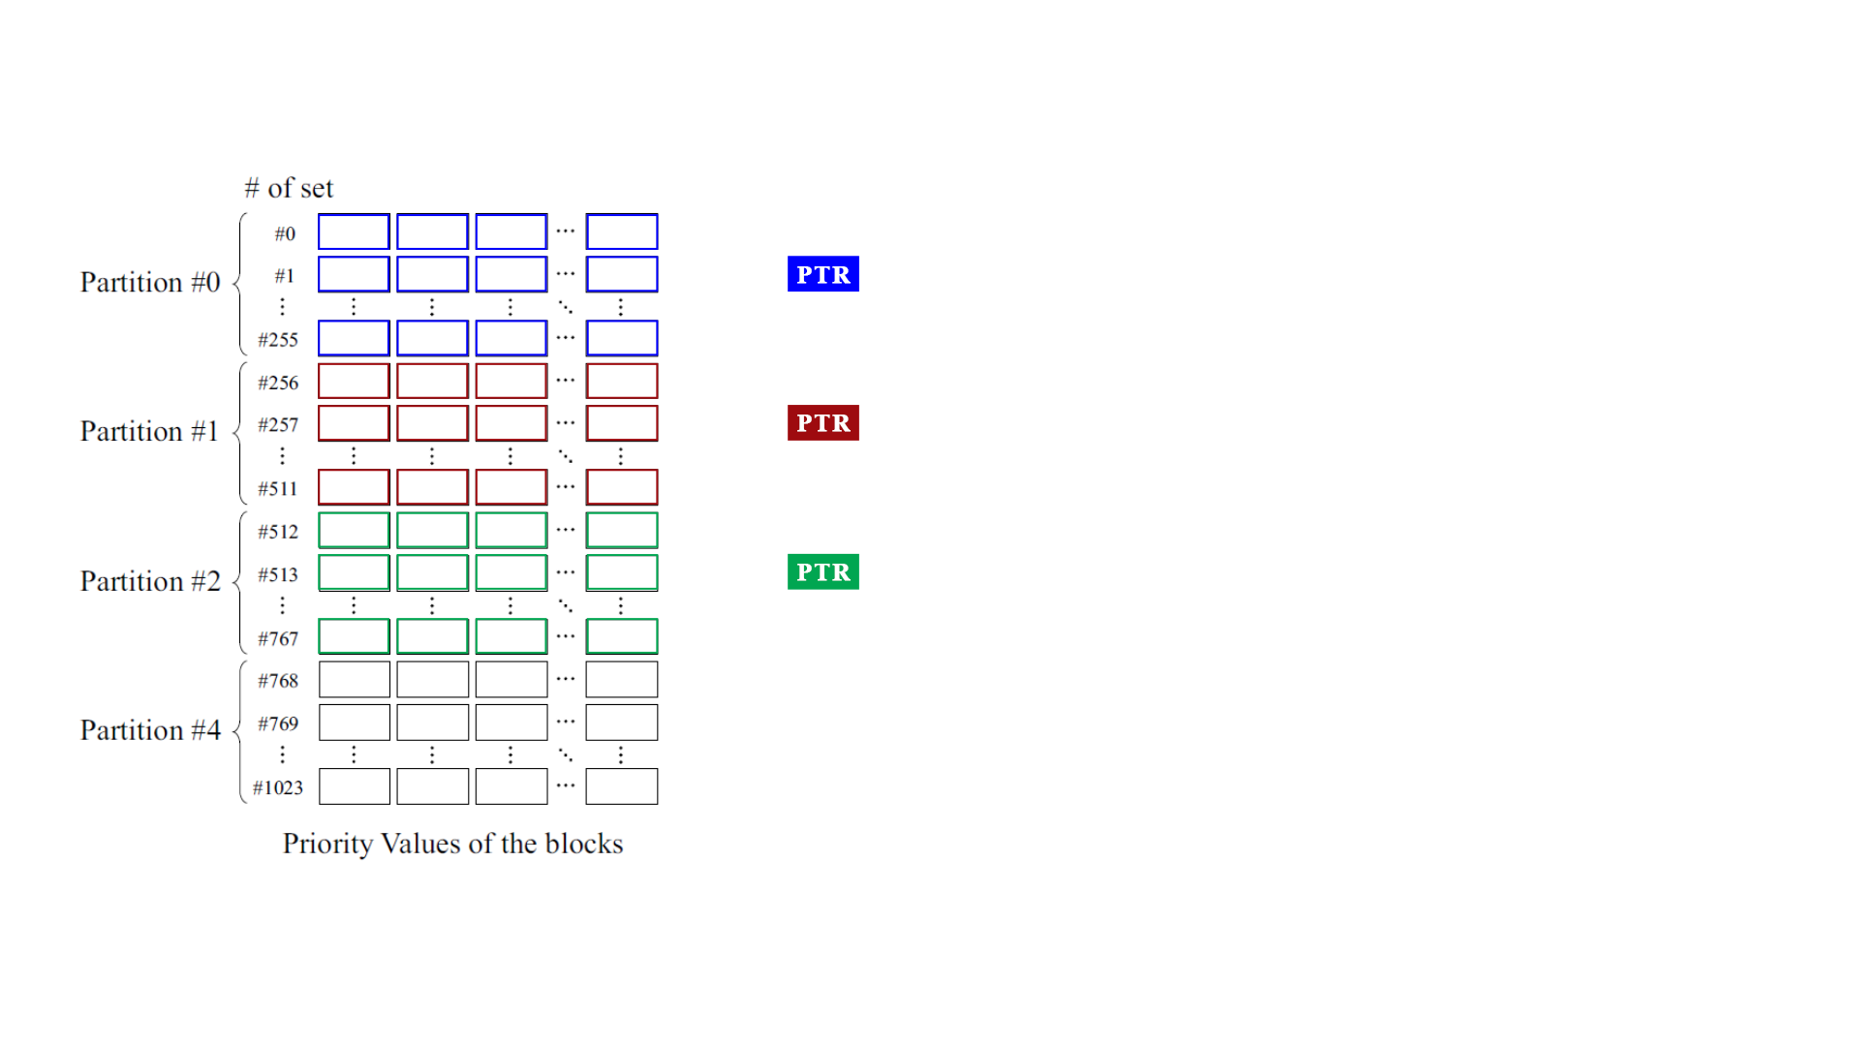
Register Mapping

Slide 29
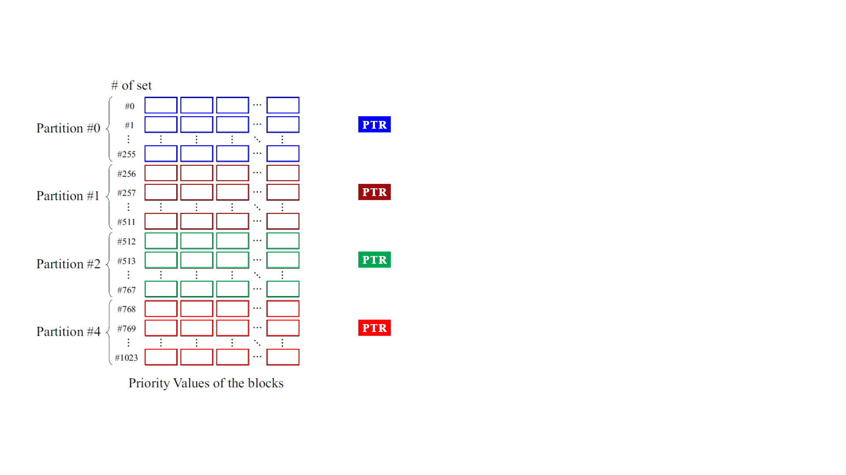
Register Mapping

Slide 30
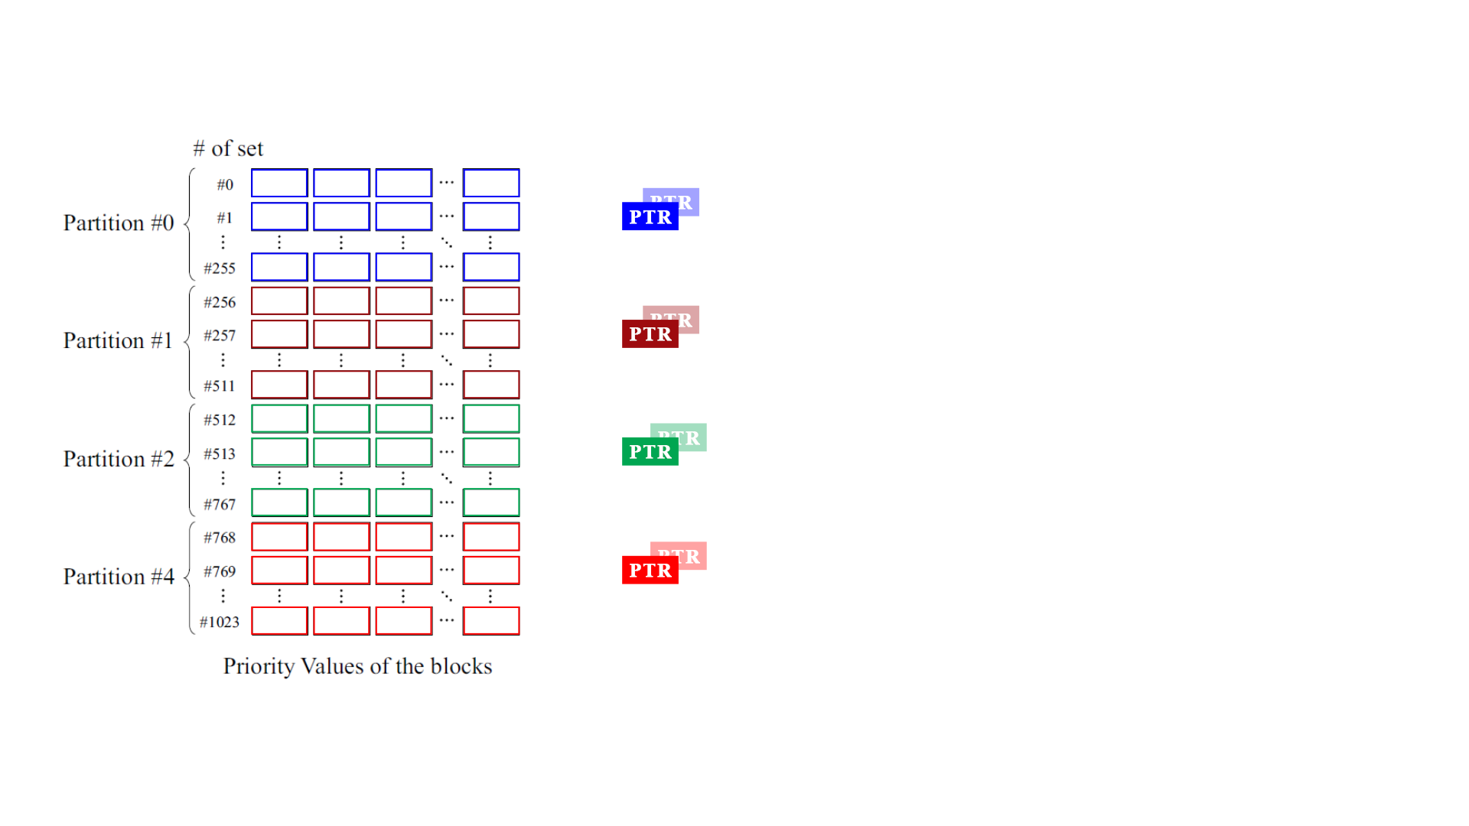
Register Mapping

Slide 31
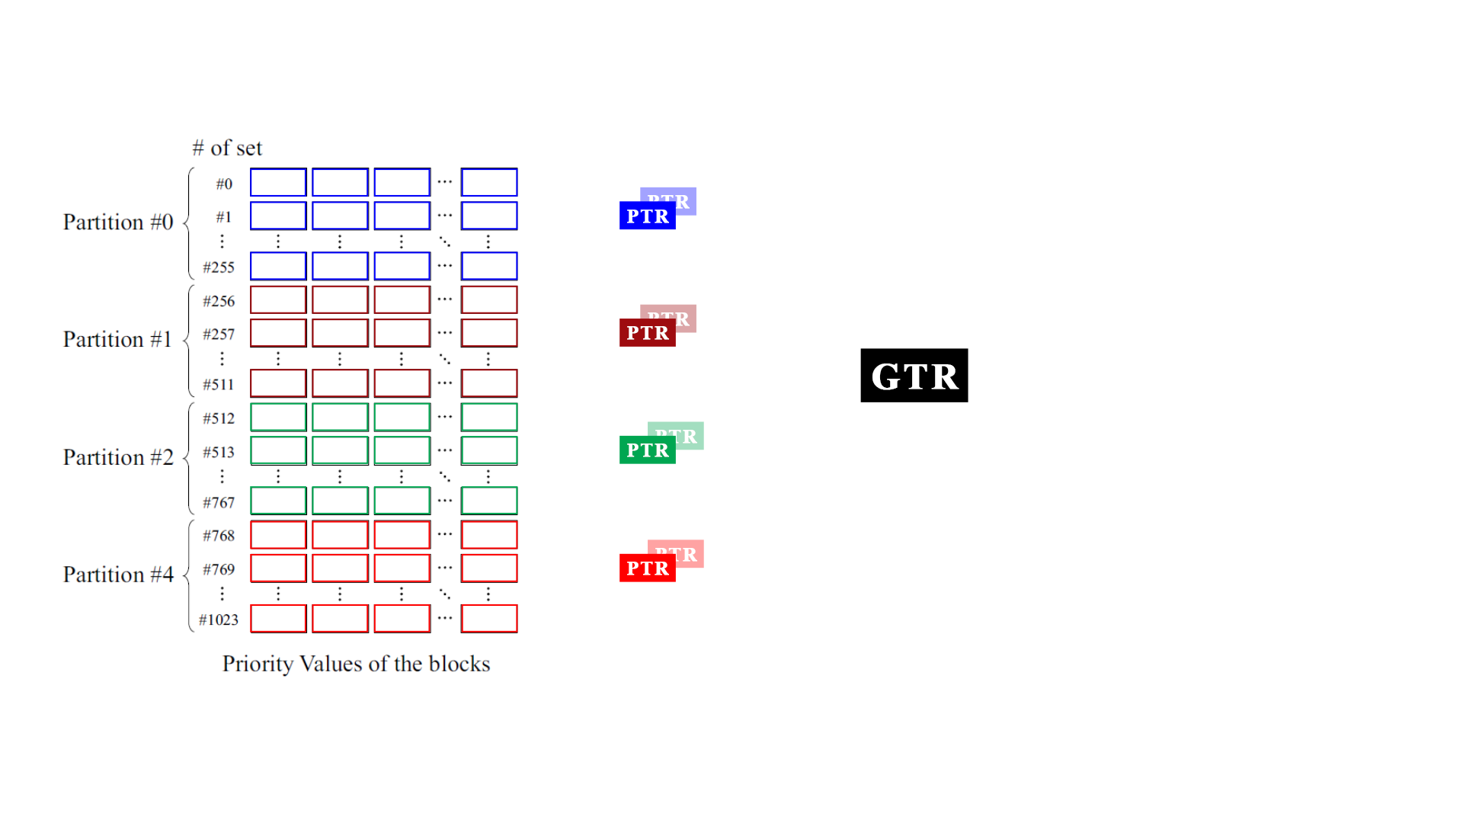
Register Mapping

Slide 32
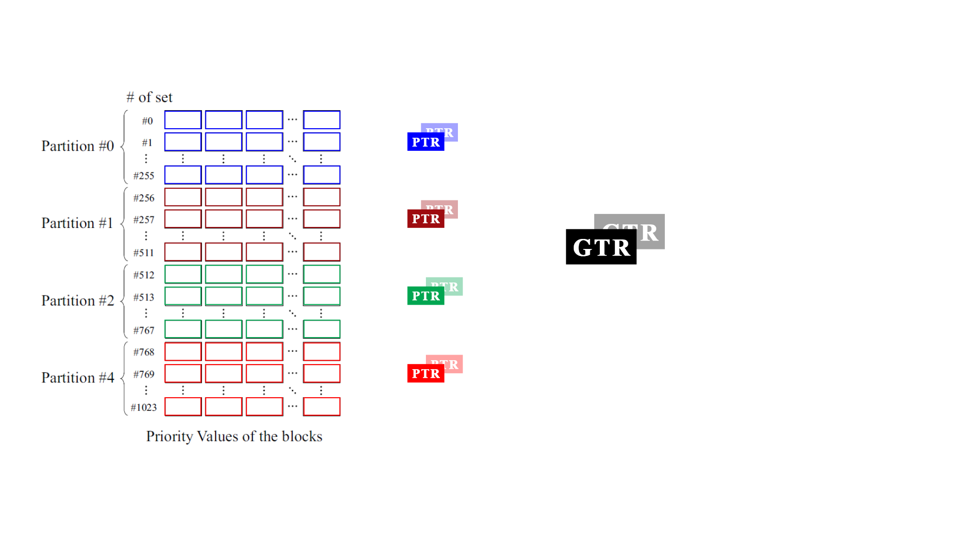
Register Mapping

Slide 33
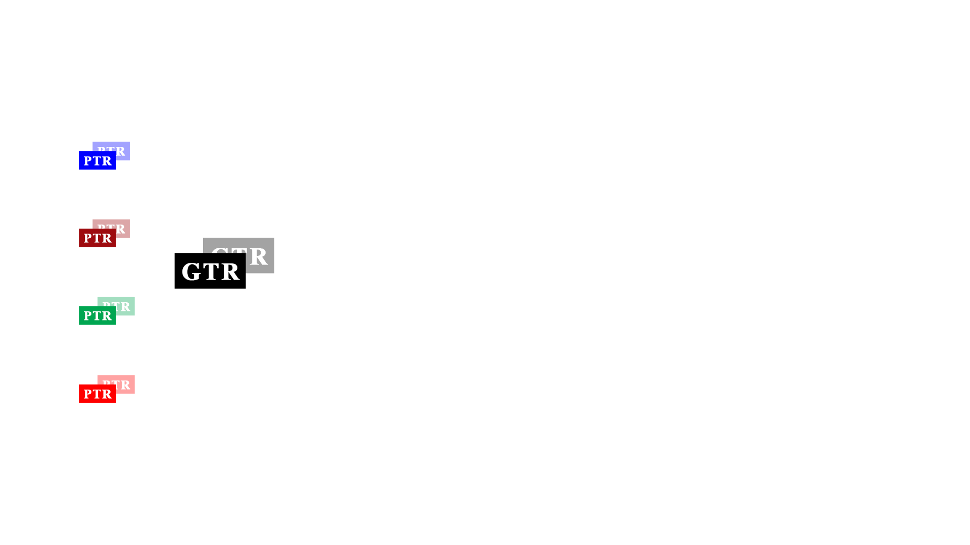
Global Fluctuations
Global Fluctuations

Slide 34
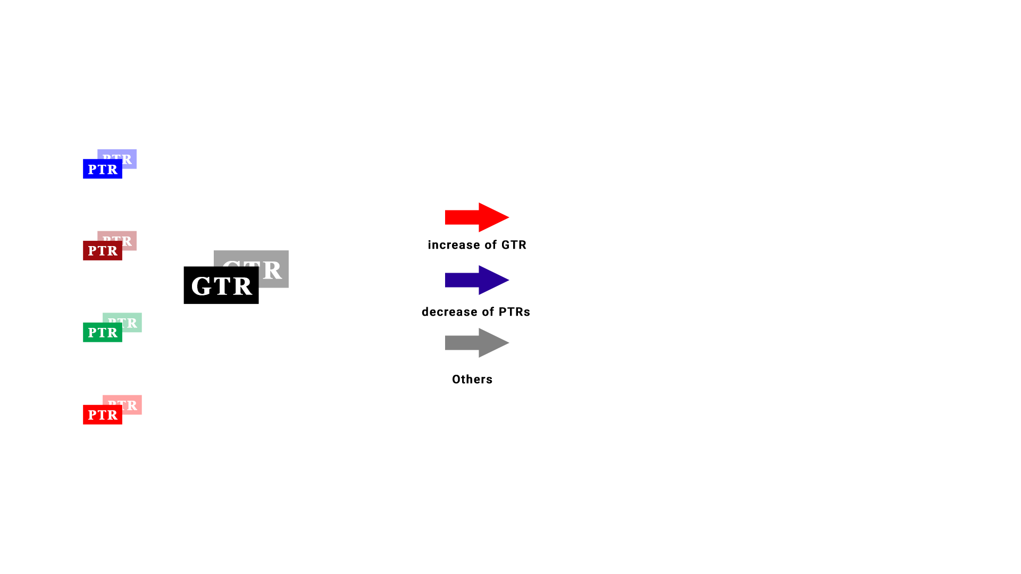
Global Fluctuations

Slide 35
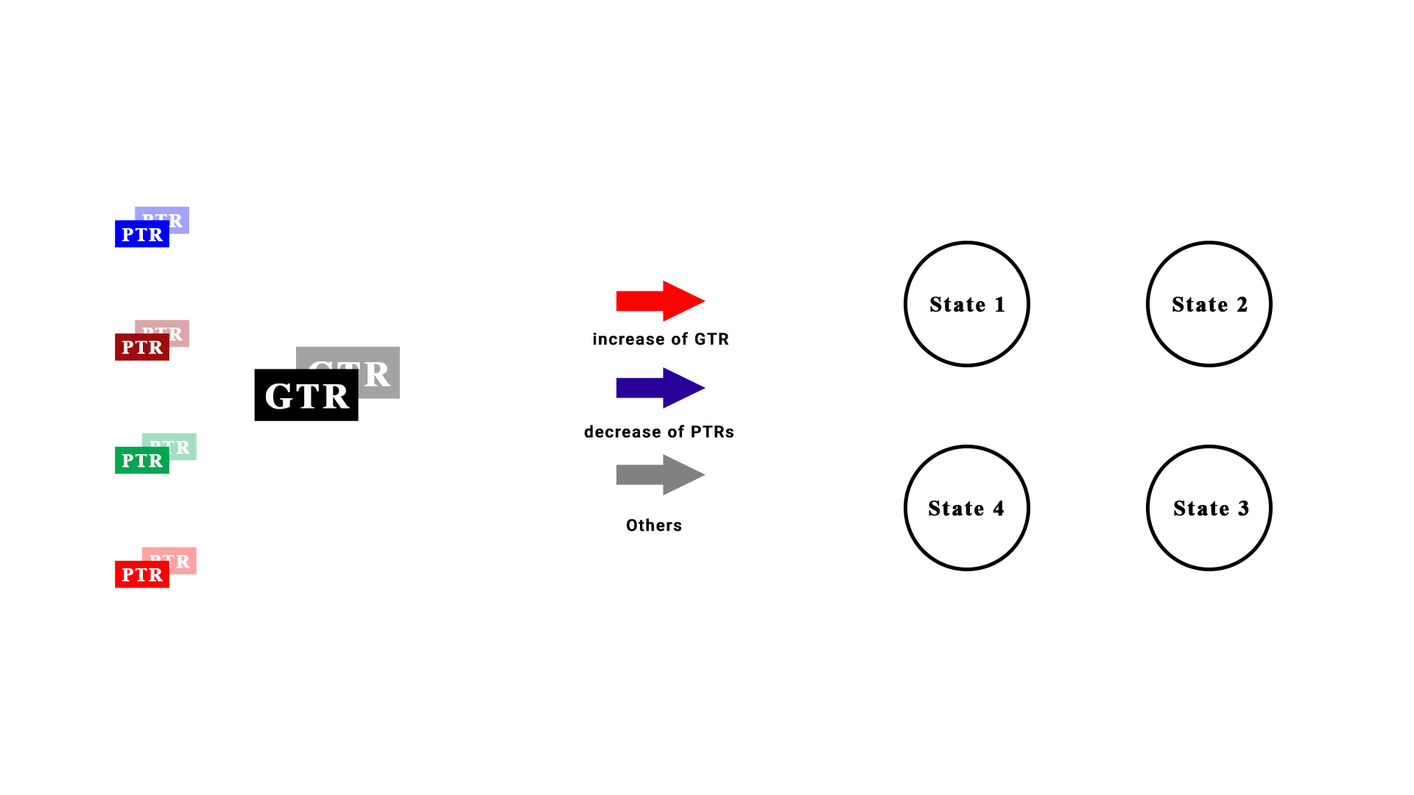
Global Fluctuations

Slide 36
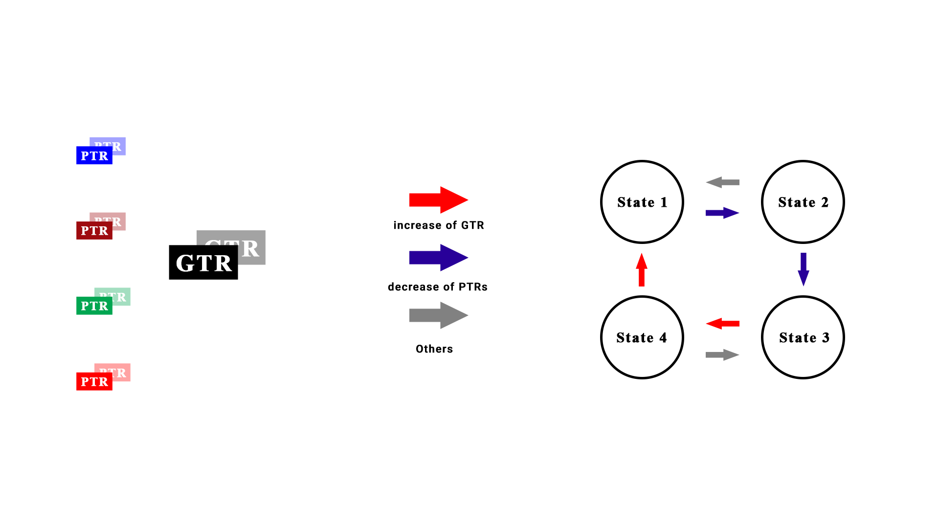
Global Fluctuations

Slide 37
Detecting Behaviour of Application
Compare recent values of GTR and PTRs to preGTR and prePTRs.
Determine state with comparison.
Jump to another state if required to support application behaviour.

Slide 38
More About States
State 1
State 2
Temporal Locality
State 4
State 3
SCAN / Thrashing Access

Slide 39
Project Plan
Apply proof of concept using C++ and Python wrapper classes in gem5 simulator.
Running the ADP-G policy on different architectures within simulator to verify results.

Slide 40
Project Plan
Experiments: We plan to use the following architecture and os for our project.
Operating system :
Ubuntu 18.04
Architecture variants:
ALPHA
ARM
x86
Notes:
ALPHA: Alpha was a family of 64-bit Alpha-based performance microprocessors designed by DEC and introduced in 1992.
ARM: ARM, previously Advanced RISC Machine, originally Acorn RISC Machine, is a family of reduced instruction set computing (RISC) architectures for computer processors, configured for various environments
x86: x86 is a family of instruction set architectures^{[a]} based on the Intel 8086 microprocessor and its 8088 variant.
Cache size assoc
L1I 32KB 8
L1D 32KB 8
L2 256KB 8
L3 2MB/4MB 16
MM 4GB -

Slide 41
Expectation
ADP-G will outperform any other existing cache replacement policy !

Slide 42
References
Jubee Tada, “A Cache Replacement Policy with Considering Global Fluctuations of Priority Values” in 2018 Sixth International Symposium on Computing and Networking Workshops (CANDARW).
J. Tada, et al., ”An Adaptive Demotion Policy for High-Associativity Caches,” in Proceedings of international symposium on Highly Efficient Accelerators and Reconfigurable Technologies (HEART2017) , 2017.

Slide 43


